Slide 1


COMPANY INTRODUCTION
2021254006 김대훈

Slide 2
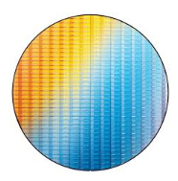
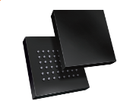
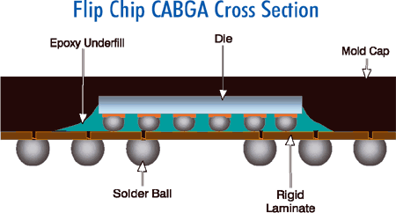
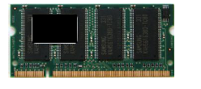
BUSINESS AREA
Intekplus는 첨단 기술 산업을 위한 2D 및 3D 검사 솔루션을 제공하며, 주로 반도체를 위한 솔루션을 제공합니다. 우리의 첨단 기술은 다양한 제품에서 사용되는 반도체를 스캔하고 검사할 수 있습니다.
Semiconductor
WAFER
FILP-CHIP
PACKAGING
MODULE
iWIS-200/300
iSIS-NBGA
iPIS-Series
iMAS/iSSD

Slide 3
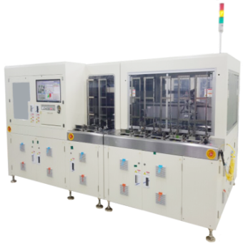
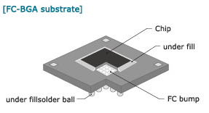

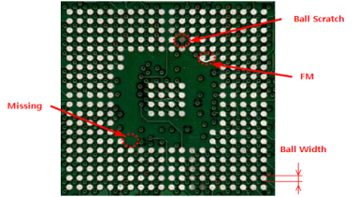
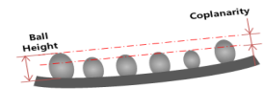
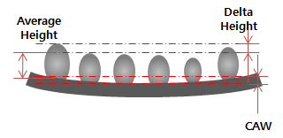
FILP - CHIP
CPU Chipset
FC-BGA Substrate
iSIS-NBGA
3D inspection for Bump Height, Coplanarity and CAW.
2D inspection for Scratch, Missing, FM and etc.
2D Inspection
3D Inspection

Slide 4
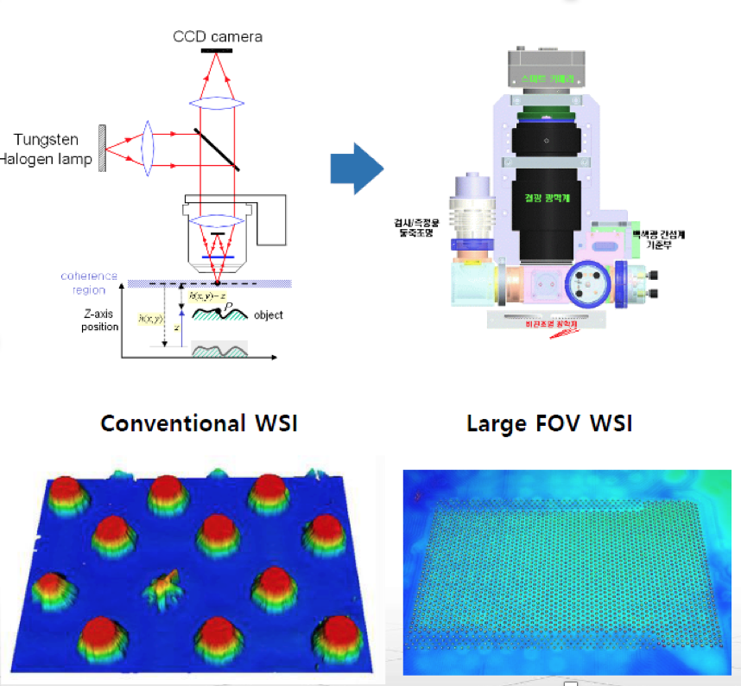
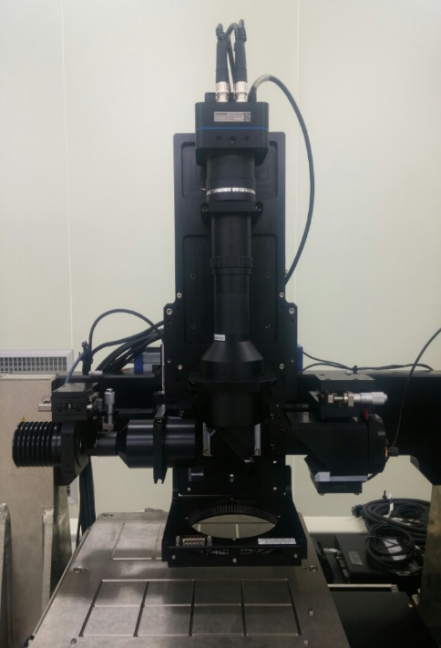
WHITE-LIGHT SCANNING INTERFEROMETRY (3D)
Real 3D WSI Module

Slide 5
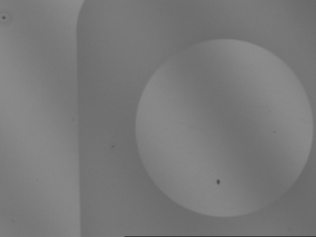
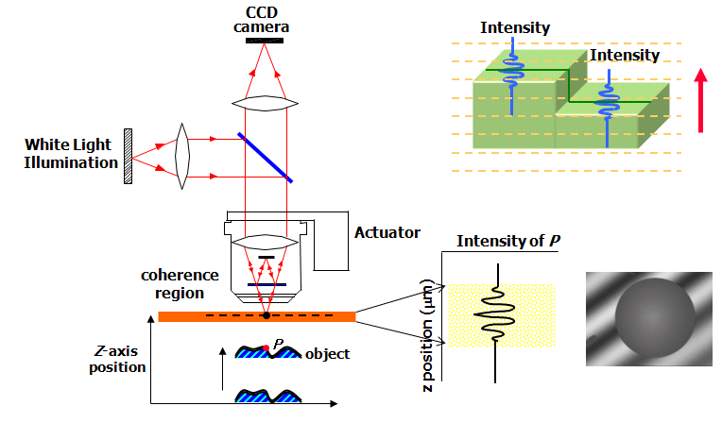
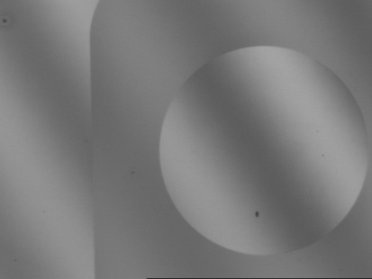
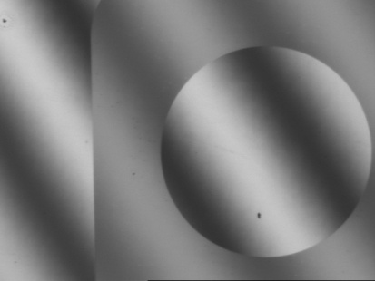
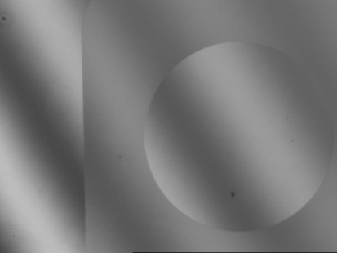
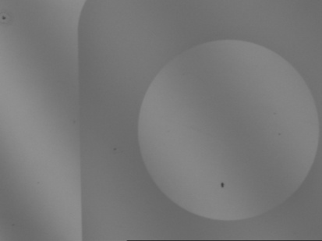
L-WSI(Whitelight Scanning Interferometry)
Basic Concept
Z=Z1
Z=Z2
Z=Z3
Z=Z4
Z=Zn

Slide 6
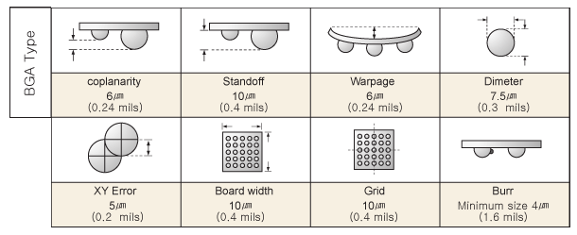
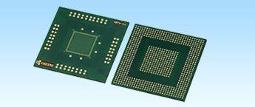
Inspection Requirements on FC-BGA substrate
C4 Area
Bump Height/ Coplanarity Chip Attach-area Warpage Bump Diameter/ offset Thickness Variation | Bump damage Bridge/ Missing bump Scratch
Top side (except C4 area)
Device Size Scratch/ Chipping/ FM Dent/ Peeling Metal Exposure Pad discoloration | MLCC Position MLCC Missing MLCC damage 2D barcode
Bottom side
Land Coplanarity Device Size Scratch/ Chipping/ FM Dent/ Peeling Pad discoloration | MLCC Position MLCC Missing MLCC damage 2D barcode

Slide 7
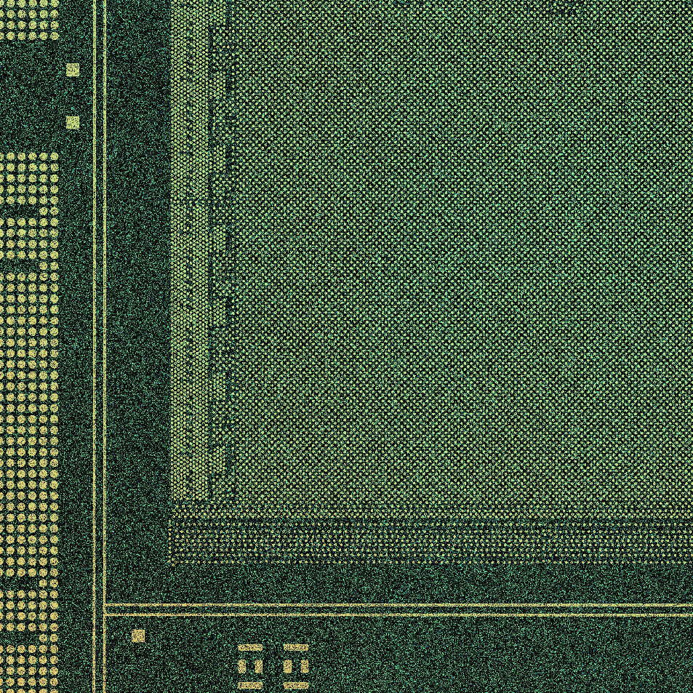
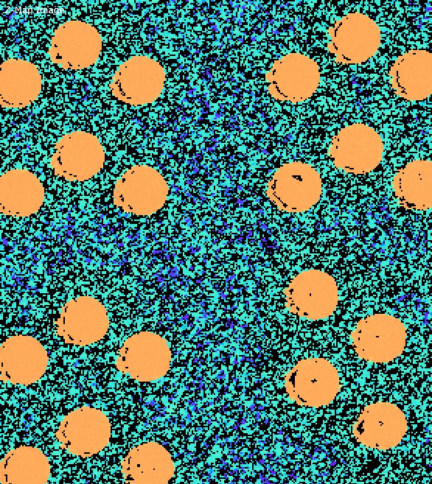
3D Inspection Items on FC-BGA substrate
Substrate[n]
Bump[n]
Real Target 3D Image
Bump[n].height = Bump[n].z - Substrate[n].z

Slide 8
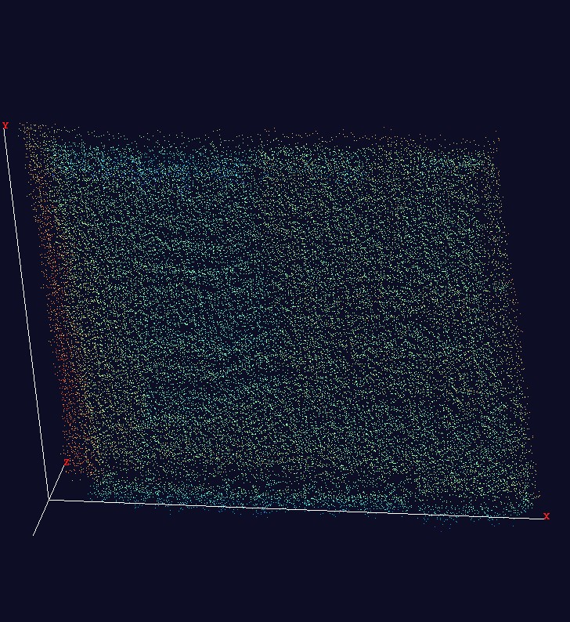
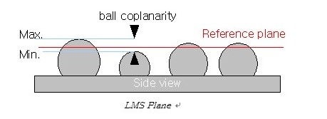
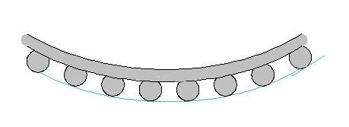
3D Inspection Items on FC-BGA substrate
warpage
Bumps z Value

Slide 9
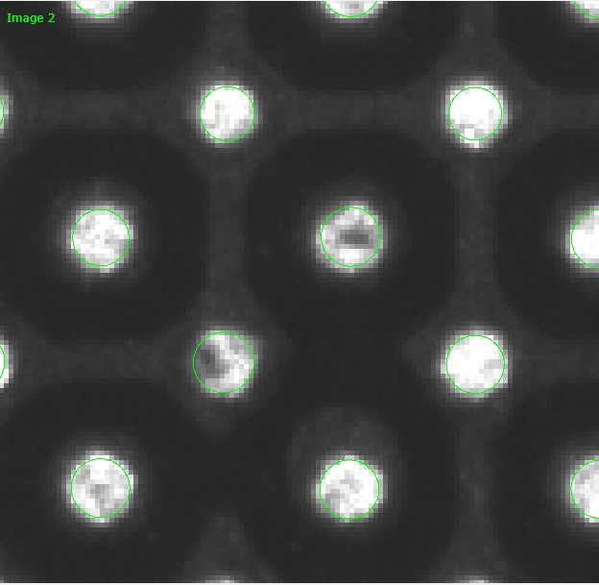
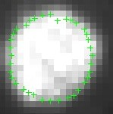
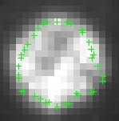
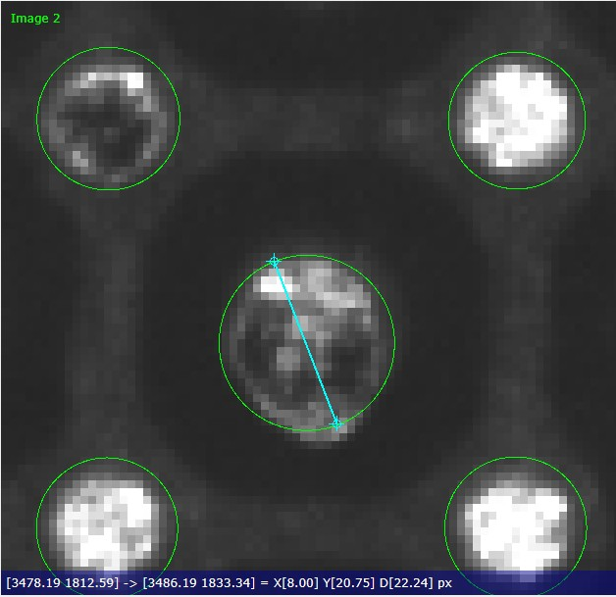
2D Inspection Items on FC-BGA substrate
Diameter size
Edge detect
Large bump : spec out 검출

Slide 10
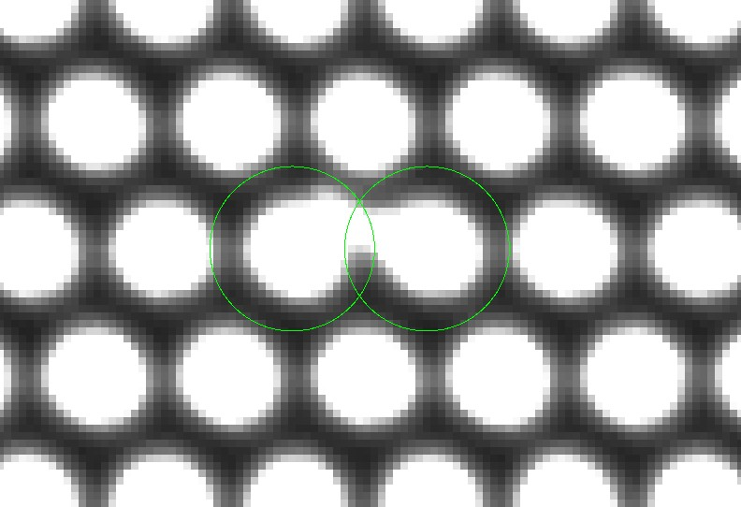
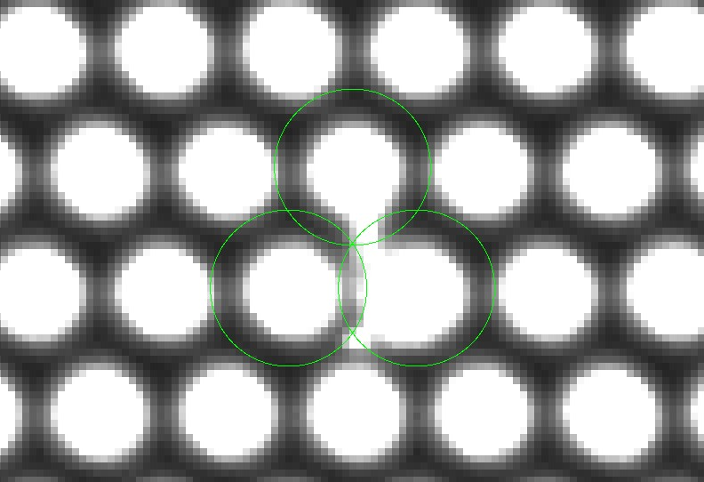
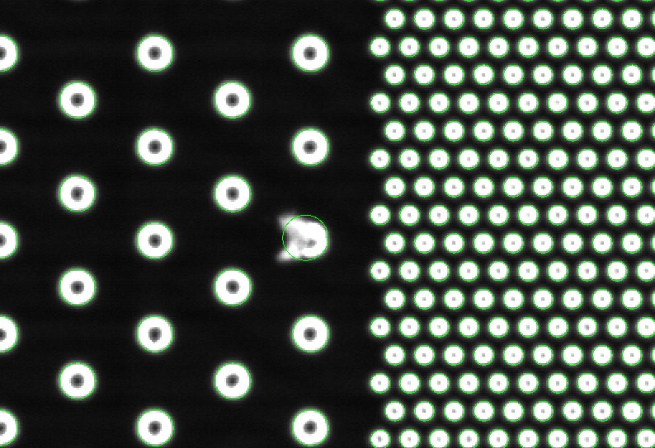
2D Inspection Items on FC-BGA substrate
Bridge 검출, 이물질 검출

Slide 11
Thank you

